Slide 1
Overview of Final Year Project
TeamGalaxy
Chia Kai Leng, Liu Zhanhong, Ng Han Xiang, Poh Yang Zhou, Shen Meilin
By PresenterMedia.com
Notes:
Good afternoon to all. Firstly, my team would like to thank our sponsor and professor for taking out this time to be here for the presentation of our final year project’s overview.

Slide 2
About us
Team Name: TeamGalaxy
Project Name: HR Galaxy
Member | Role
Liu Zhan Hong | Project Manager
Ng Han Xiang | Deputy Project Manager & Business Analyst
Shen Meilin | Business Analyst & Tester
Chia Kai Leng | Database Developer
Poh Yang Zhou | Lead Developer
Notes:
Team name is TeamGalaxy.
These are the 5 main roles that each of us will be in charged of.
Project Manager by Zhan Hong who will be facilitating meetings, plan and manage progress of project.
Deputy Project Manager will be Han Xiang who will oversee the project documentation and business analysis.
I will be the business analyst and tester for the application.
Kaileng will be in charged of database and will also be managing the contents in the school’s wikipedia page.
Yang Zhou will be the lead developer of the application.
We will be rotating our roles while each of our main role still remain.
Name of our project is HR Galaxy.

Slide 3
Agenda
Great Eastern
What is missing out there?
Product Comparison
Market Survey
Features of our Osmosis
Scope of Application
Prototype
Risk Mitigation
Project Schedule with Milestone
Notes:
This is the agenda for today. I will be going through our roles in this project and challenges faced.
Zhan hong will be going through existing HR system in the market and their advantages and also the features, goal and scope of our application.
Prototype will be done by yang zhou.
Hanxiang will present risk mitigation and project schedule.

Slide 4

Clients
Regional Manager - Ong Lih Yenn
Project Manager - Jennifer Du
How the partnership started?
In need of a way to better conduct recruitment and promote it’s talent pool
Notes:
Now just a short introduction about our client, Great Eastern. It all started when the 3 of my team members hx,kl,ml during their internship wanted to improve on their legacy system but the regional manager of the Group IT department, Mr. Ong shared with us that GE currently is looking for a way to
- better manage their human resource more efficiently
conduct recruitment and promoting its talent pool in a more efficient manner
traditional recruitment avenue like jobs dbwebsites out there are not able to meet their needs due to
Thus we looked into these issues and identify the shortfalls of the

Slide 5
Our group’s motivation for this project
To develop a product that is able to solve business problem

Slide 6



Current

Slide 7
Market survey

Slide 8
What do they offer to companies?
Platform to reach out to jobseekers
What do they offer to individuals?
A platform to look for jobs

Slide 9
What is missing in the market?
A platform that connects businesses
Why? There is a need to facilitate the process for companies to discover and engage services provided by other companies

Slide 10
What is missing in the market?
Utilizing the existing repository of resumes
!) to built competitive advantage by marketing employees
2) Resumes are used for advertising individuals
Notes:
Individuals are strategic resources of company
thus can also be used for marketing employees

Slide 11
What is missing in the market?
Companies are always represented as a single entity rather than given a choice to be represented as different departments.
The department knows better what kind of candidates they need

Slide 12
Features | Social Media Platform (LinkedIn) | Online job portals | OSMOSIS
How are jobs marketed to potential candidates? | LinkedIn Platform & Post to Twitter | Own website and other mediums. This is dependent on the portal's marketing campaign. | Our own website and Facebook
Allow Posting of Jobs | ✓ Post Job | ✓ Post Job | ✓ Post Job
Allow Subscription of content | Yes | Yes | Yes

Slide 13
Features | Social Media Platform (LinkedIn) | Online job portals | OSMOSIS
Allow Posting of Services | X | X | ✓
Organize companies into different units for different departments | X | X | ✓
Allow companies to discover services offered by other companies/individuals | X | X | ✓
Allow companies to provide insights into companies’ competencies by showcasing her employees’ experiences. | X Tag as own employees (but they don’t advertise) | X | ✓ Tag own employee skills to company page

Slide 14
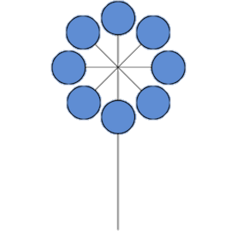
What is Osmosis?
A platform where organizations are able to discover and engage the services of other organizations or individuals.
Notes:
organizations are able to discover and engage the services of other organizations or individuals. Osmosis aims to create an ecosystem where services offered by organizations and individuals a-liked can be traded freely. Traditional medium focuses more on the job profile of individuals but neglected the needs of the organisation who are always looking for ways to develop their talent pool and to market their capability and the service that they are able to provide tog as a team or department. Thus this is why we decided to create a platform where organisation can organise themselve into units to market the capability of their talent and individuals can also do so as we also recognise that some of them might be free lancer who would also like to provide their servie.

Slide 15
Features of Osmosis
Post & Advertising of Service
Maintain Company/Individual profile
Create Units within Company
Enable tagging of employees
Subscribing to Company/Individual Profile
Notes:
One of the xfactor of Osmosis is that we allow companies and individuals to post service online, meaning that for example, Great Eastern may require a team of well known personnel who specializes in cloud computing technologies or they would need a new event company to handle one of their new event and through our platforms and companies who are be able to fulfill these requirements will be able to apply for this service job. Thus this is how it leads to companies able to discover new services provided by other companies or individuals.
Next company are able to maintain and promote their profile and advertise on the services and the talents that are carrying out this service. As we know that a company contains various department or function unit that may offer various kind of service or , we introduce a feature where they are allow to create of units within the company profile and units are able to tag employees and advertising different kinds of services that they provide. These units may also be able to search through for service they require or people for the job positions they are hiring. What we want to recreate here is to empower diff departments within a co to be able to do their own recruitment or services first before recommending to their central HR or .
The tagging of employees would give recognition to employees and at the same time allow companies to advertise their talent pool for the benefits of the co and to the employees as well.
And lastly companies will be able to subscribe to other company or individual profile to receive updates from them. So really what we want to create here is a platform that will replace the scenario when people need a particular service or to fill a job position they will always tap into their private network and our platforms would really give biz professionals a place to discover new biz opportunities and talents everyday.

Slide 16
Benefits of Osmosis
Unified platform that leads to convenience, time is saved
Allow companies to make more
informed decision
Create new opportunities for employees
& companies

Slide 17
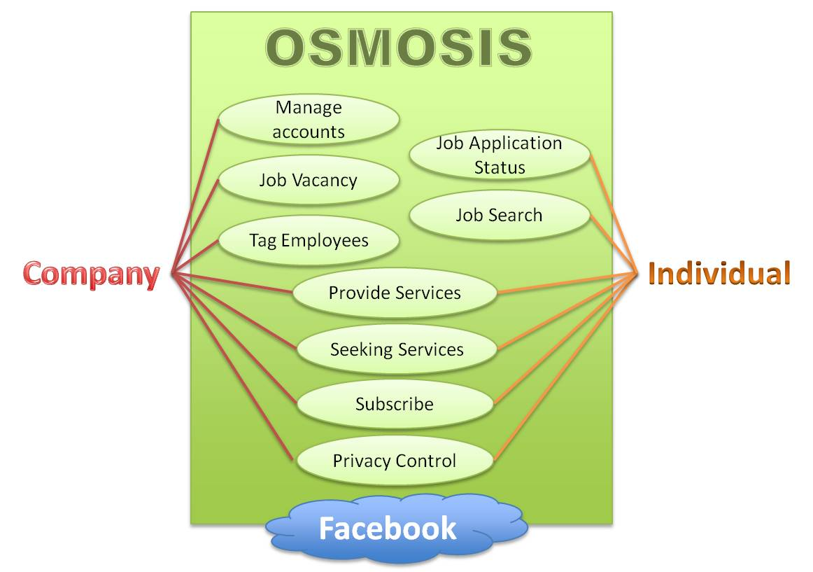
Project Scope
Notes:
One of the xfactor of Osmosis is that we allow companies and individuals to post service online, meaning that for example, Great Eastern may require a team of well known personnel who specializes in company insurance. Thus they are able to post a service

Slide 18
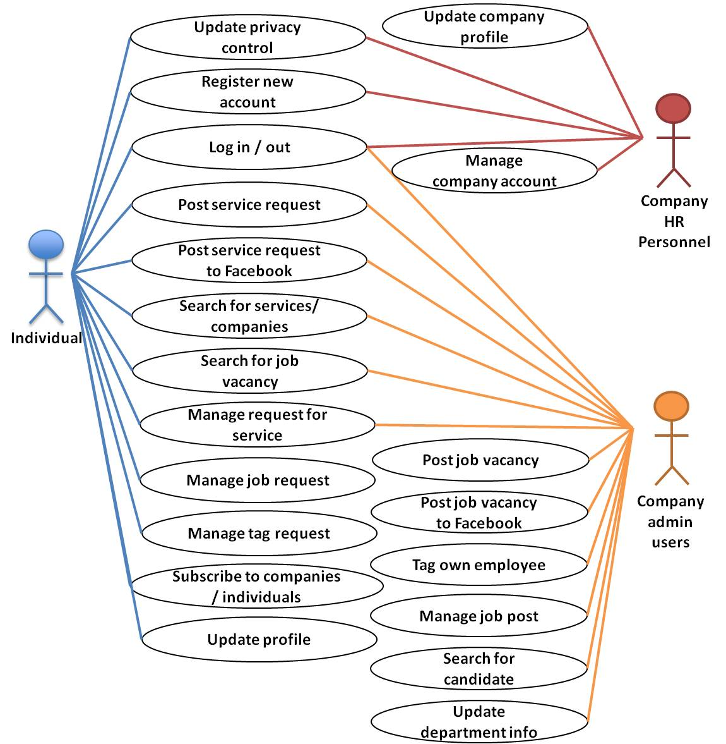
Uses Cases
Notes:
One of the xfactor of Osmosis is that we allow companies and individuals to post service online, meaning that for example, Great Eastern may require a team of well known personnel who specializes in company insurance. Thus they are able to post a service

Slide 19
Paper Prototype

Slide 20
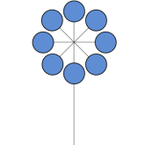

Osmosis
Logout | Individual
Company
Search..
News Feed
Service
Profile
Service:
Company: Service Description:
Type: Budget:
Services
Service:
Jobs
Company: Service Description:
Type: Budget:
Subscriptions
Service:
Company: Service Description:
Type: Budget:
Notification
Service:
Company: Service Description:
Type: Budget:

Slide 21

Osmosis
Logout | Individual
Company
Search..
Profile
Profile
Name:
Zen Liu
Contact:
9XXX XXXX
Services
Gender:
M
Email:
zen@osmosis.com
Company:
Position:
Team Galaxy
xxxxxxxxx
Jobs
Skills:
XXX:
XXX
Subscriptions
Experiences:
Notification
XXX:
XXX
Education:
XXX:
XXX

Slide 22
Osmosis
Logout | Individual
Company
Search..
Profile
Manage Profile
Manage Account
Services
Post Service
Manage Services
Jobs
Job Status
Subscriptions
View Subscriptions
Notification
Subscribers Feed
Latest Job
Latest Services

Slide 23
Osmosis
Logout | Company
Company
Search..
Profile
Manage Profile
Manage Account
Manage Unit
Services
Post Service
Manage Services
Jobs
Job Status
Post Jobs
Subscriptions
View Subscriptions
Notification
Subscribers Feed
Latest Job
Latest Services

Slide 24

Osmosis
Logout | Company
Company
Search..
Company Profile
Profile
Company:
Name
Great Eastern
Contact:
xxxxxxxx
Services
Industry:
Insurance
Email:
ge@greateastern.com
Established:
1908
Address:
Jobs
Company URL:
www.greateastern.com
Company Description:
Subscriptions
XXX:
XXX
Notification
Units:
1. Human Resource Edit | Delete
2. Finance Edit | Delete
3. Marketing Edit | Delete
4. Sales Edit | Delete
Notes:
Address
Company website

Slide 25
Osmosis
Logout | Unit
Company Admin
Company
Search..
Great Eastern
Profile
Human Resource
Industry:
Insurance
Contact:
xxxxxxxx
Services
Services:
Human Resource
Email:
ge@greateastern.com
Established:
Jobs
1908
Description:
XXX:
XXX
Subscriptions
Notification
Employees
Photo
Name:
Photo
Name:
Photo
Name:
Position:
Position:
Position:
Photo
Name:
Photo
Name:
Photo
Name:
Position:
Position:
Position:

Slide 26
Osmosis
Logout | Company
Company
Search..
Create Unit:
Profile
Add
Edit
Delete
Services
Unit Name:
Human Resource
Person In-Charge:
Shen Meilin
Jobs
Username:
xxxxxxxxxx
Password:
xxxxxxxxxx
Subscriptions
Units:
Notification
1. Human Resource Edit | Delete
2. Finance Edit | Delete
3. Marketing Edit | Delete
4. Sales Edit | Delete

Slide 27
Osmosis
Logout | Company
Company
Search..
Tag Employee
Profile
Search Employee:
Type username here
Services
Result
Show All
Photo
Name Age
Jobs
Position Location
Tag
Subscriptions
Photo
Name Age
Tag
Position Location
Notification
All Tagged Employees
Show All
Photo
Name
Photo
Name
Photo
Name
Position
Position
Position
Photo
Name
Photo
Name
Photo
Name
Position
Position
Position

Slide 28
Osmosis
Logout | Company
Company
Search..
Company search:
Profile
Result
Services
Company Name
Photo
Industry
Jobs
Company’s description
Subscriptions
Company Name
Photo
Notification
Industry
Company’s description
Show All

Slide 29
Osmosis
Logout | Company
Company
Search..
Post Services
Profile
Title
Services
Industry
Duration
Start
End
Jobs
Budget
Services Required
Subscriptions
Description
Notification
Reset
Post
Service Summary
Start
End
Title
Start
End
Title

Slide 30
Osmosis
Logout | Company
Company
Search..
Profile
Search Employee:
Type username here
Services
Result
Name
Jobs
Photo
Position
tag
Company
Subscriptions
Notification
All tagged employees
Name
Photo
delete
Position
Company

Slide 31
Osmosis
Logout | Company
Company
Search..
Profile
Company search:
Result
Services
Company Name
Photo
Jobs
Industry
Company’s description
Subscriptions
Company Name
Notification
Photo
Industry
Company’s description

Slide 32
Osmosis
Logout | Company
Company
Search..
Services
Profile
Posting Service
Title
Services
Industry
Jobs
Duration
Start
End
Subscriptions
Budget
Services required
Notification
Description
Reset
Post
Summary of requests
Request 1

Slide 33
Company
Search..
Individuals
Jobs

Slide 34
What language will we be using
Javascript
AngularJS
Allows the extension of HTML vocabulary for web application that results in an environment that is extraordinarily expressive, readable, and quick to develop.

Slide 35
Project Management Methodology
Iterative process
Client’s feedback can be sought periodically
Tailored to the client’s demand as much as possible.
Project Management tool
Microsoft Project
Minimal learning curve
Notes:
As product is delivered over time at regular intervals, client’s feedback can be sought periodically thereby ensuring that the final product delivered would be tailored to the client’s demand as much as possible.

Slide 36
Risk Mitigation
Risk | Impact Level | Mitigation Plan
Using an unfamiliar programming language | Low | Ensure that all group members conduct research on JavaScript Lead developer to conduct peer teaching sessions to ensure that all members understand the programming language
Sudden change in policy of LinkedIn which leads to some methods in LinkedIn API being either highly limited in usages or removed | High | Research on other social medias and evaluate their applicability with regard to integrating with the HR application. Ensure that there are alternatives.
Notes:
For the risk on this project, we have identify 3. the first one is the use of unfamiliar programming language. For now, we have going to code the application using C#. Which to most of us is the first time except yang zhou, who is our lead developer. Some risk that we may faced will be the slowness in coding our function thus delaying of delivery. So to prevent this, we all will undergo research to understand on this language and crash course will be given by the lead developer. Working in pair for iteration 4 (during holiday) to pick up the language to get ready for the actual term.
Second is the change of LinkedIn policy. This risk is actually very high cause a change in their policy might cause us to bleech their new policy or unavailable of functions. To prevent this from happening, we research on various other social media developer tools to determine their applicability

Slide 37
Risk Mitigation
Risk | Risk Level | Mitigation Plan
Changes in the project requirements from client | Medium | Establish a change control process where the impact and scope of the change will be evaluated by the members involved in creating the functions. The evaluation would then conclude whether or not a change is required.
Notes:
Change of user requirement due to business nature, redoing the form, database etc that may hinder delivery date.

Slide 38
Project Schedule
Date | Task
07 Oct 2012 | Start of Final Year Project
26 Oct 2012 | Project Proposal Submission
05 – 08 Nov 2012 | Project Acceptance
07 Jan 2013 | Registration
18 – 22 Feb 2013 | Mid Term
15 – 24 Apr 2013 | Final
26 Apr 2013 | Poster Day (Project showcase)

Slide 39
Pre-Term (24 Sept – 04 Jan)
Iteration | Week | Date | Tasks
1 | 1 | 24 Sept – 28 Sept | Market Research Technologies Research Drafting of scope
 | 2 | 01 Oct – 05 Oct
2 | 3 | 8 Oct - 12 Oct | Application Storyboarding Exploration of Frameworks
 | 4 | 15 Oct – 19 Oct
3 | 5 | 22 Oct – 26 Oct | Project Proposal Project Documentation Connect to LinkedIn Function Project Acceptance Presentation
 | 6 | 29 Oct – 02 Nov
 | 7 | 05 Nov - 08 Nov
Academic Projects and Examination (11 Nov – 7 Dec)
4 | 1 | 10 Dec – 14 Dec | Database design Role Base Management
 | 2 | 17 Dec – 21 Dec
5 | 3 | 24 Dec – 28 Dec | Basic Interface design Employee Management Function
 | 4 | 31 Dec – 04 Jan

Slide 40
Actual Term (07 Jan – 26 Apr)
Iteration | Week | Date | Tasks
5 | 1 | 07 Jan – 11 Jan | Hire Staff Proposal Function Report Factory Function (Phase 1)
 | 2 | 14 Jan – 18 Jan
6 | 3 | 21 Jan – 25 Jan | Report Factory Function (Phase 1) Sponsor UAT
 | 4 | 25 Jan – 01 Feb
7 | 5 | 04 Feb – 08 Feb | School UAT UAT Review
 | 6 | 11 Feb – 15 Feb
8 | 7 | 18 Feb – 22 Feb | Mid Term Presentation Mid Term Review Add Event Function
 | 8 | 25 Feb – 01 Mar

Slide 41
Actual Term (07 Jan – 26 Apr)
Iteration | Week | Date | Tasks
9 | 9 | 04 Mar – 08 Mar | Contract Management Leave Management Function
 | 10 | 11 Mar – 15 Mar
10 | 11 | 18 Mar – 22 Mar | Report Factory Function (Phase 2) Usability Enhancement (design/bugs solving) School UAT
 | 12 | 25 Mar – 29 Mar
11 | 13 | 01 Apr – 05 Apr | Sponsor UAT UAT Review
 | 14 | 08 Apr – 12 Apr
12 | 15 | 15 Apr – 19 Apr | Final Presentation
 | 16 | 22 Apr – 26 Apr
Notes:
Oracle database, apache on windows servers, << ONE MORE RISK >>
Taking information from the public domain and turn it into a private pipeline.
Idea: cloud platform for companies to upload their employee’s skills to everyone around the world. And could be a platform for companies to sell their services and at the same time, recruitment plus head hunt. (recruitment via different social medias and hosting them on the web)
Business intelligence. (
Integration of certain current application outside on the web.
Anchor: benefits less to us but benefits GE more.
Social media + Recruitment
(company level (service direction, head hunt) more towards private, individual level (job find, being headhunted) more public)

Slide 42
Learning Outcomes
Notes:
One of the xfactor of Osmosis is that we allow companies and individuals to post service online, meaning that for example, Great Eastern may require a team of well known personnel who specializes in company insurance. Thus they are able to post a service

Slide 43
Features of Osmosis
Post & Advertising of Service
Maintain Company/Individual profile
Create Units
Enable tagging of employees
Subscribing to Company/Individual Profile
Notes:
One of the xfactor of Osmosis is that we allow companies and individuals to post service online, meaning that for example, Great Eastern may require a team of well known personnel who specializes in company insurance. Thus they are able to post a service

Slide 44

-END- Questions & Answers
Thank you

